Slide 1
SENTIMENT ANALYSIS
Natural Language Understanding - CSL 7340

Slide 2


POSITIVE OR NEGATIVE MOVIE REVIEW?
unbelievably disappointing
Full of zany characters and richly applied satire, and some great plot twists
this is the greatest screwball comedy ever filmed
It was pathetic. The worst part about it was the boxing scenes.

Slide 3
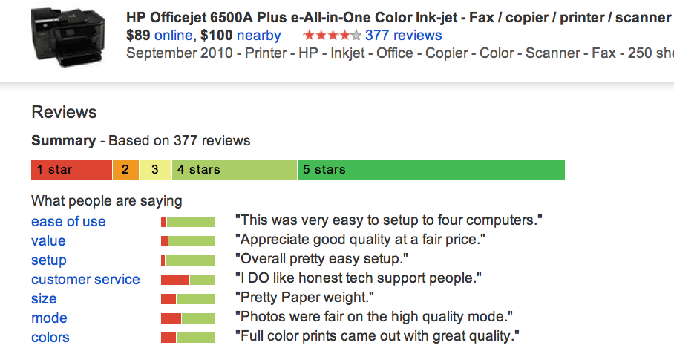
GOOGLE PRODUCT SEARCH
a

Slide 4
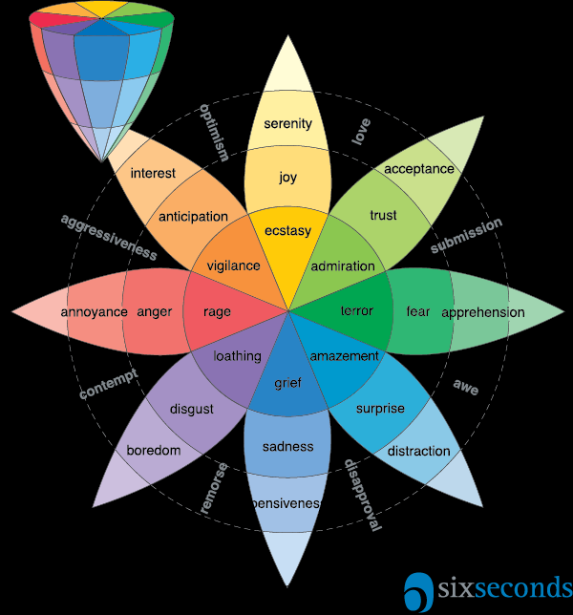
SENTIMENT ANALYSIS
Interpretation and classification of sentiments (positive, negative and neutral) within text data
Different variants
Positive / Negative / Neutral
Happy / Sad / Angry / bored
Finer Nuances

Slide 5
SCHERER TYPOLOGY OF AFFECTIVE STATES
Emotion: brief organically synchronized … evaluation of a major event
angry, sad, joyful, fearful, ashamed, proud, elated
Mood: diffuse non-caused low-intensity long-duration change in subjective feeling
cheerful, gloomy, irritable, listless, depressed, buoyant
Interpersonal stances: affective stance toward another person in a specific interaction
friendly, flirtatious, distant, cold, warm, supportive, contemptuous
Attitudes: enduring, affectively colored beliefs, dispositions towards objects or persons
liking, loving, hating, valuing, desiring
Personality traits: stable personality dispositions and typical behavior tendencies
nervous, anxious, reckless, morose, hostile, jealous
Money Markets - Investment apps - predictive analytics for stocks
Upselling - what is the best time
Designing a chatbot
Recommender Systems
Personality Assessment
for potential roles as leaders / sales person
for counseling

Slide 6
DEFINING SENTIMENT ANALYSIS
Simplest task:
Is the attitude of this text positive or negative?
More complex:
Rank the attitude of this text from 1 to 5
Advanced:
Detect the target, source, or complex attitude types
Quantify - Correlate with Numerical Business data (Sales / CSI)
Actionable Intelligence
Improve Business Data

Slide 7
COMPLEX TASKS
Sentiment analysis is the detection of attitudes / polarity / emotion
“enduring, affectively colored beliefs, dispositions towards objects or persons”
Holder (source) of attitude - more information - male / female / mother / father / sibling
Target (aspect) of attitude - in a mood to buy? / only enquiry?
Type of attitude - difficult or easy customer
From a set of types
Like, love, hate, value, desire, etc.
Or (more commonly) simple weighted polarity:
positive, negative, neutral, together with strength
Text containing the attitude
Sentence or entire document

Slide 8
SENTIMENT ANALYSIS HAS MANY OTHER NAMES
Opinion extraction
Opinion mining
Sentiment mining
Subjectivity analysis

Slide 9
WHY SENTIMENT ANALYSIS?
Movie: is this review positive or negative?
Products: what do people think about the new iPhone?
Public sentiment: how is consumer confidence? Is despair increasing?
Politics: what do people think about this candidate or issue?
Prediction: predict election outcomes or market trends from sentiment

Slide 10
GRANULARITY AND APPROACHES
Word Level
Sentence Level
Text Level
Rule Based
Machine Learning
Mixed
Lexicon based approach
A lexicon which attaches sentiment information to each word
Positive Score + Negative Score + Neutral score = 1.0

Slide 11
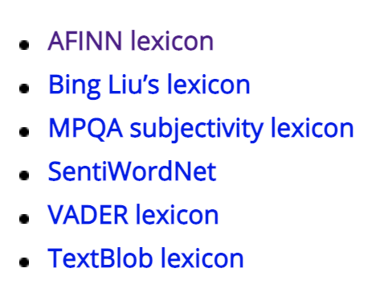
RULE BASED - using LEXICONS
Sentence <w1, w2, w3,…, wn> -
Total Positive score - ∑P(w_{i})
Total Negative score – ∑N(w_{i})
Total Neutral score – ∑O(w_{i})
Sentiment class = argmax_{j} (Pos, Neg, Obj)

Slide 12
SENTIWORDNET
Stefano Baccianella, Andrea Esuli, and Fabrizio Sebastiani. 2010 SENTIWORDNET 3.0: An Enhanced Lexical Resource for Sentiment Analysis and Opinion Mining. LREC-2010
Home page: http://sentiwordnet.isti.cnr.it/
All WordNet synsets automatically annotated for degrees of positivity, negativity, and neutrality/objectiveness
[estimable(J,3)] “may be computed or estimated”
Pos 0 Neg 0 Obj 1
[estimable(J,1)] “deserving of respect or high regard”
Pos .75 Neg 0 Obj .25

Slide 13
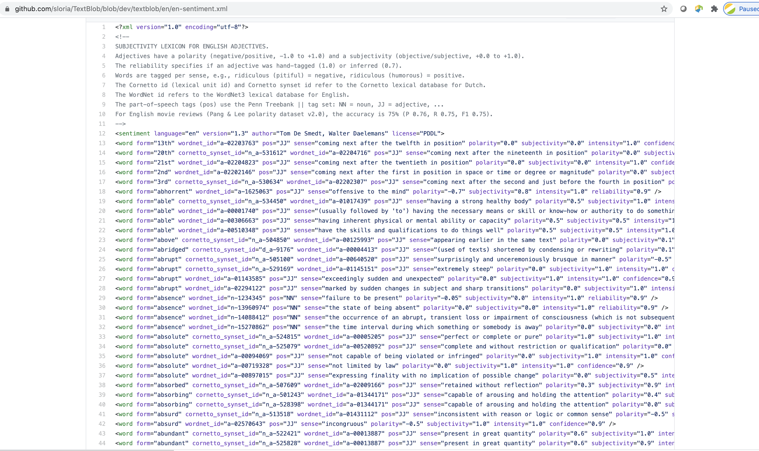
Textblob

Slide 14
BING LIU OPINION LEXICON
Minqing Hu and Bing Liu. Mining and Summarizing Customer Reviews. ACM SIGKDD-2004.
Bing Liu's Page on Opinion Mining
http://www.cs.uic.edu/~liub/FBS/opinion-lexicon-English.rar
6786 words
2006 positive
4783 negative

Slide 15
DISAGREEMENTS BETWEEN POLARITY LEXICONS
Christopher Potts, Sentiment Tutorial, 2011
 | Opinion Lexicon | General Inquirer | SentiWordNet | LIWC
MPQA | 33/5402 (0.6%) | 49/2867 (2%) | 1127/4214 (27%) | 12/363 (3%)
Opinion Lexicon |  | 32/2411 (1%) | 1004/3994 (25%) | 9/403 (2%)
General Inquirer |  |  | 520/2306 (23%) | 1/204 (0.5%)
SentiWordNet |  |  |  | 174/694 (25%)
LIWC

Slide 16
IMDB DATA IN THE PANG AND LEE DATABASE
✓
✗
when _star wars_ came out some twenty years ago , the image of traveling throughout the stars has become a commonplace image . […]
when han solo goes light speed , the stars change to bright lines , going towards the viewer in lines that converge at an invisible point .
cool .
_october sky_ offers a much simpler image–that of a single white dot , traveling horizontally across the night sky . [. . . ]
“ snake eyes ” is the most aggravating kind of movie : the kind that shows so much potential then becomes unbelievably disappointing .
it’s not just because this is a brian depalma film , and since he’s a great director and one who’s films are always greeted with at least some fanfare .
and it’s not even because this was a film starring nicolas cage and since he gives a brauvara performance , this film is hardly worth his talents .

Slide 17
TOKEN-BASED CLASSIFICATION
Tokenization
Feature Extraction
Classification using different classifiers
Naïve Bayes
MaxEnt
SVM

Slide 18
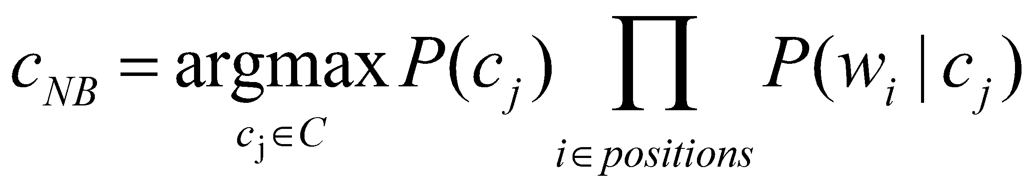
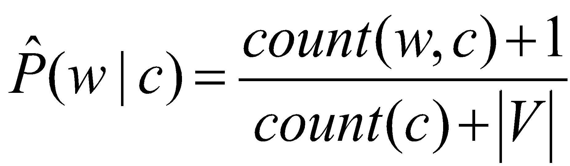
REMINDER: NAÏVE BAYES

Slide 19
BINARIZED (BOOLEAN FEATURE) MULTINOMIAL NAÏVE BAYES
Intuition:
For sentiment (and probably for other text classification domains)
Word occurrence may matter more than word frequency
The occurrence of the word fantastic tells us a lot
The fact that it occurs 5 times may not tell us much more.
Boolean Multinomial Naïve Bayes
Clips all the word counts in each document at 1

Slide 20
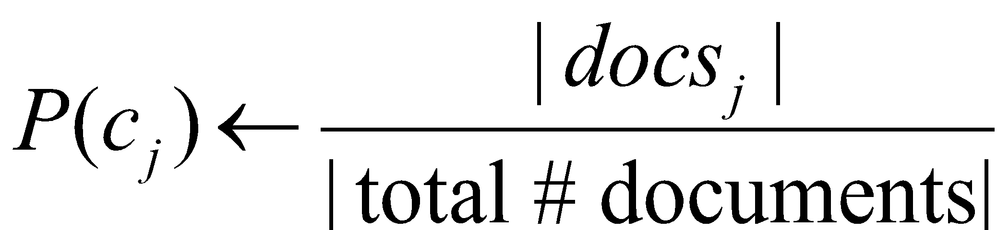
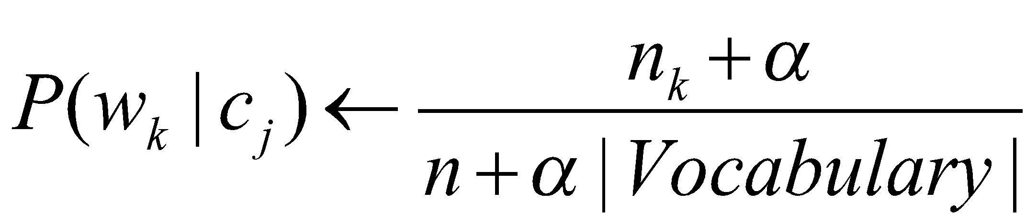
BOOLEAN MULTINOMIAL NAÏVE BAYES: LEARNING
From training corpus, extract Vocabulary
Remove duplicates in each doc:
For each word type w in doc_{j}
Retain only a single instance of w
Text_{j} ← single doc containing all docs_{j}
For each word w_{k} in Vocabulary
n_{k} ← # of occurrences of w_{k} in Text_{j}
Calculate P(c_{j}) terms
For each c_{j} in C do
docs_{j} ← all docs with class =c_{j}
Calculate P(w_{k} | c_{j}) terms

Slide 21
BOOLEAN MULTINOMIAL NAÏVE BAYES ON A TEST DOCUMENT D
First remove all duplicate words from d
Then compute NB using the same equation:

Slide 22
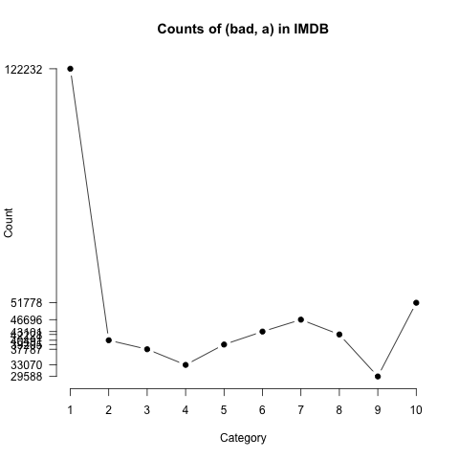
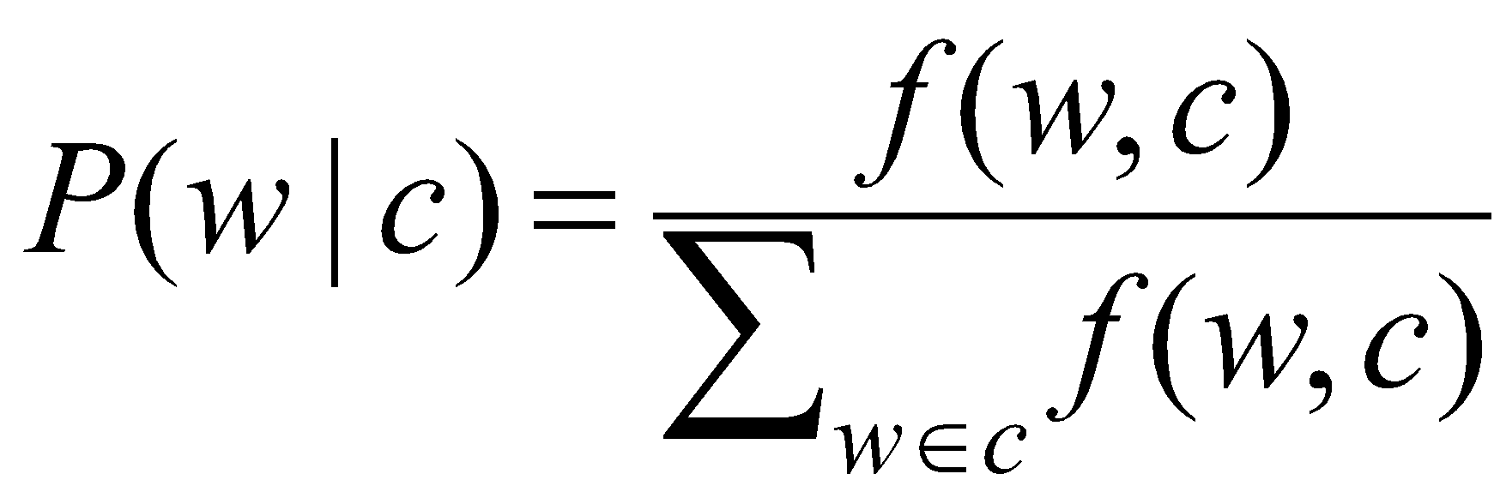
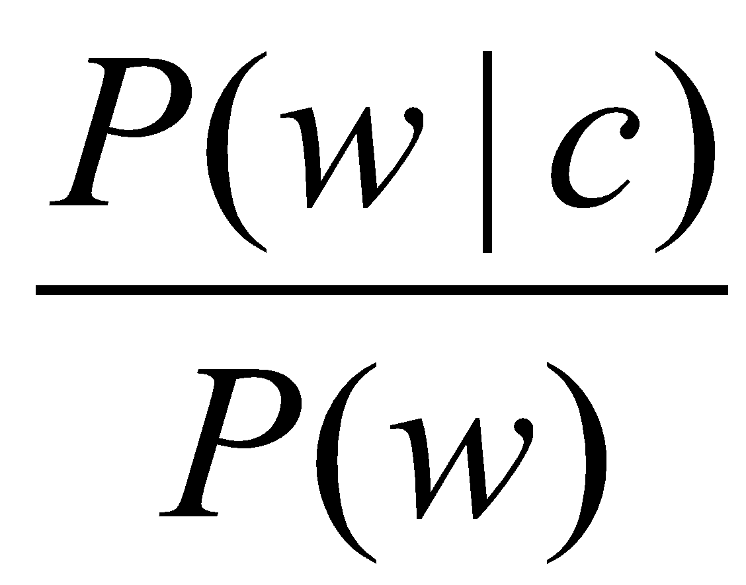
ANALYZING THE POLARITY OF EACH WORD IN IMDB
How likely is each word to appear in each sentiment class?
Count(“bad”) in 1-star, 2-star, 3-star, etc.
But can’t use raw counts:
Instead, likelihood:
Make them comparable between words
Scaled likelihood:
Notes:
Thanks to Chris Potts for permission to use figure

Slide 23
SEMI-SUPERVISED LEARNING OF LEXICONS
Use a small amount of information
A few labeled examples
A few hand-built patterns
To bootstrap a lexicon

Slide 24
INTUITION FOR IDENTIFYING WORD POLARITY
Adjectives conjoined by “and” have same polarity
Fair and legitimate, corrupt and brutal
*fair and brutal, *corrupt and legitimate
Adjectives conjoined by “but” do not
fair but brutal

Slide 25
EXAMPLE - STEP 1
Label seed set of 1336 adjectives (all >20 in 21 million word WSJ corpus)
657 positive
adequate central clever famous intelligent remarkable reputed sensitive slender thriving…
679 negative
contagious drunken ignorant lanky listless primitive strident troublesome unresolved unsuspecting…

Slide 26
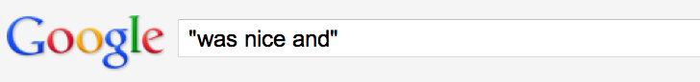
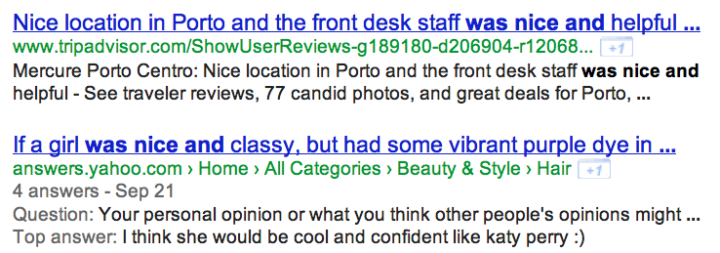
STEP 2
Expand seed set to conjoined adjectives
nice, helpful
nice, classy

Slide 27
STEP 3
Supervised classifier assigns “polarity similarity” to each word pair, resulting in graph:
brutal
helpful
corrupt
irrational
nice
fair
classy

Slide 28
STEP 4
Clustering for partitioning the graph into two
+
-
brutal
helpful
corrupt
irrational
nice
fair
classy

Slide 29
OUTPUT POLARITY LEXICON
Positive
bold decisive disturbing generous good honest important large mature patient peaceful positive proud sound stimulating straightforward strange talented vigorous witty…
Negative
ambiguous cautious cynical evasive harmful hypocritical inefficient insecure irrational irresponsible minor outspoken pleasant reckless risky selfish tedious unsupported vulnerable wasteful…

Slide 30
OUTPUT POLARITY LEXICON
Positive
bold decisive disturbing generous good honest important large mature patient peaceful positive proud sound stimulating straightforward strange talented vigorous witty…
Negative
ambiguous cautious cynical evasive harmful hypocritical inefficient insecure irrational irresponsible minor outspoken pleasant reckless risky selfish tedious unsupported vulnerable wasteful…

Slide 31
Problem - How to handle negation and Valence
This movie is not at all watchable
This movie is not watchable
This movie is just watchable
This movie is watchable
Which words to use?
Only adjectives?
All words? - How to handle

Slide 32
EXTRACT TWO-WORD PHRASES WITH ADJECTIVES
First Word | Second Word | Third Word (not extracted)
JJ | NN or NNS | anything
RB, RBR, RBS | JJ | Not NN nor NNS
JJ | JJ | Not NN or NNS
NN or NNS | JJ | Nor NN nor NNS
RB, RBR, or RBS | VB, VBD, VBN, VBG | anything

Slide 33
TURNEY ALGORITHM
Extract a phrasal lexicon from reviews
Learn polarity of each phrase
Rate a review by the average polarity of its phrases

Slide 34
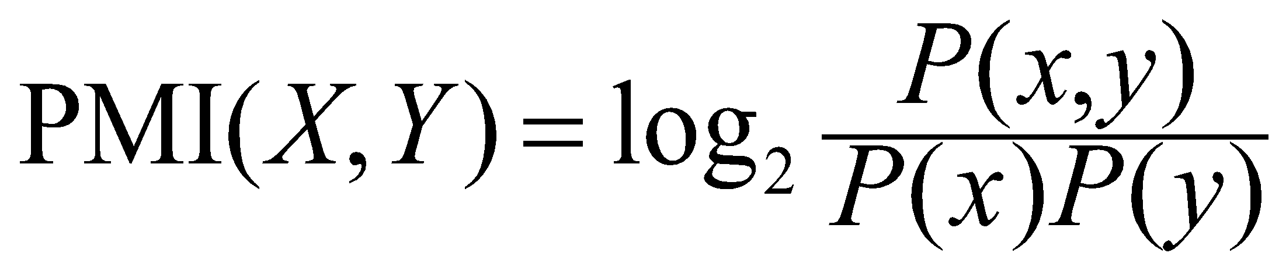
POINTWISE MUTUAL INFORMATION
How much more do events x and y co-occur than if they were independent?
Vocabulary size is - N
x, y and z are three words - with frequencies fx and fy and fz
y is excellent - z is poor - x is watchable
y is +ve / z is -ve
P(y) = P(z)
P(xz) > P(xy) - since watchable co-occurs more with “poor” than “excellent”
How much more does a phrase occur “NEAR” a positive word than a “negative” word or vice-versa?

Slide 35
HOW TO MEASURE POLARITY OF A PHRASE?
Positive phrases co-occur more with “excellent”
Negative phrases co-occur more with “poor”
But how to measure co-occurrence?

Slide 36

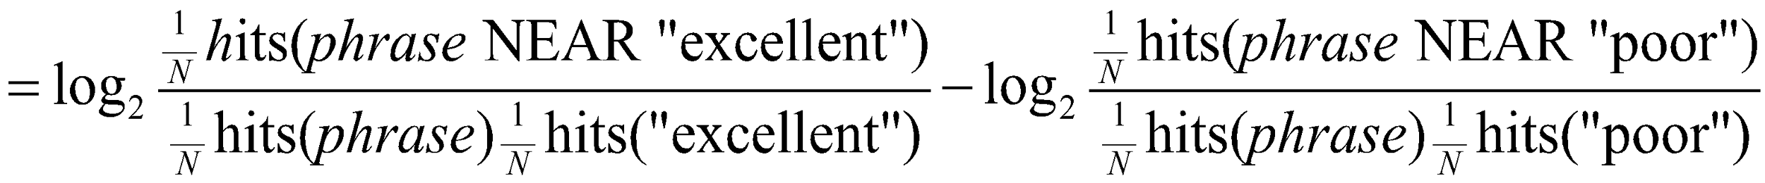
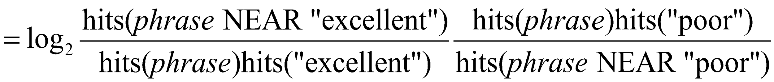
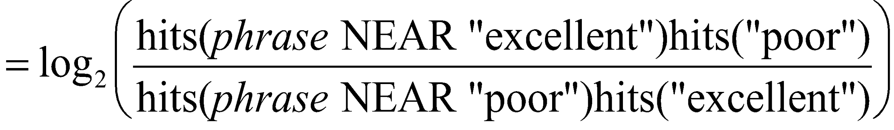
DOES “PHRASE” APPEAR MORE WITH “POOR” OR “EXCELLENT”?

Slide 37
PHRASES FROM A THUMBS-UP REVIEW
Phrase | POS tags | Polarity
online service | JJ NN | 2.8
online experience | JJ NN | 2.3
direct deposit | JJ NN | 1.3
local branch | JJ NN | 0.42
…
low fees | JJ NNS | 0.33
true service | JJ NN | -0.73
other bank | JJ NN | -0.85
inconveniently located | JJ NN | -1.5
Average |  | 0.32

Slide 38
PHRASES FROM A THUMBS-DOWN REVIEW
Phrase | POS tags | Polarity
direct deposits | JJ NNS | 5.8
online web | JJ NN | 1.9
very handy | RB JJ | 1.4
…
virtual monopoly | JJ NN | -2.0
lesser evil | RBR JJ | -2.3
other problems | JJ NNS | -2.8
low funds | JJ NNS | -6.8
unethical practices | JJ NNS | -8.5
Average |  | -1.2

Slide 39
PUTTING IT ALL TOGETHER: FINDING SENTIMENT FOR ASPECTS
Sentences
& Phrases
Sentences
& Phrases
Sentences
& Phrases
Final
Summary
Reviews
Text
Extractor
Sentiment
Classifier
Aspect
Extractor
Aggregator

Slide 40
FINDING ASPECT/ATTRIBUTE/TARGET OF SENTIMENT
The aspect name may not be in the sentence
We went because of the free fare promised and was pleasantly pleased ...
How to handle “new unseen words” - new aspects
We reached early but were soon sorted and went to the beach
The grubb was excellent
How to handle spelling mistakes / random abbreviations

Slide 41
THWARTED EXPECTATIONS AND ORDERING EFFECTS
“This film should be brilliant. It sounds like a great plot, the actors are first grade, and the supporting cast is good as well, and Stallone is attempting to deliver a good performance. However, it can’t hold up.”
Well as usual Keanu Reeves is nothing special, but surprisingly, the very talented Laurence Fishbourne is not so good either, I was surprised.

Slide 42
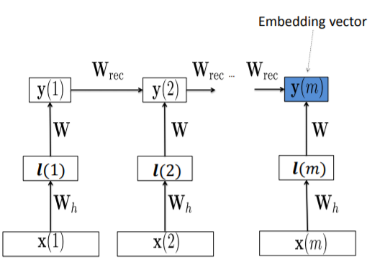
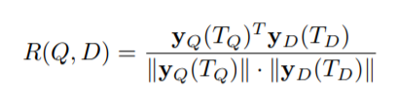
CAN DEEP LEARNING ARCHITECTURE DO BETTER?
Test Sentence
Positive Sentence
Negative Sentence

Slide 43
HOTEL REVIEWS
Rooms (3/5 stars, 41 comments)
(+) The room was clean and everything worked fine – even the water pressure ...
(+) We went because of the free room and was pleasantly pleased ...
(-) …the worst hotel I had ever stayed at ...
Service (3/5 stars, 31 comments)
(+)
(+)
(+) Every single hotel staff member treated us great and answered every ...
(-) The food is cold and the service gives new meaning to SLOW.
Dining (3/5 stars, 18 comments)
(+) our favorite place to stay in biloxi.the food is great also the service ...
(+) Offer of free buffet for joining the Play

Slide 44
PROBLEMS: How to handle Sarcasms and Illocutionary aspects?
Perfume review in Perfumes: the Guide:
“If you are reading this because it is your darling fragrance, please wear it at home exclusively, and tape the windows shut.”
Dorothy Parker on Katherine Hepburn
“She runs the gamut of emotions from A to B”

Slide 45
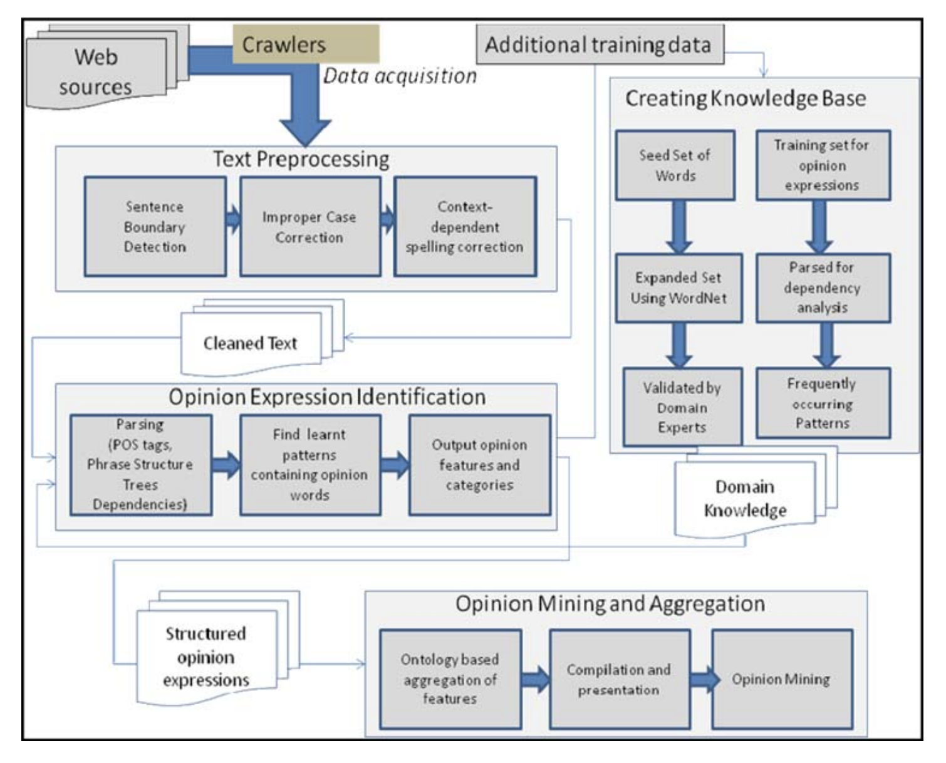

Slide 46
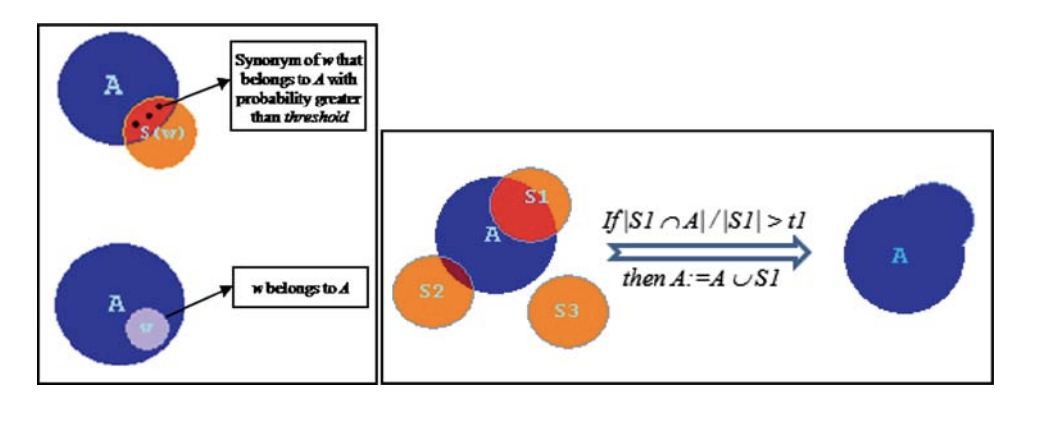
An Algorithm to Add Domain-dependent sentiment words to Standard Lexicons
If two words have majority of their WordNet synonyms also overlap - then two words belong to same polarity - new word inducted into Dictionary

Slide 47
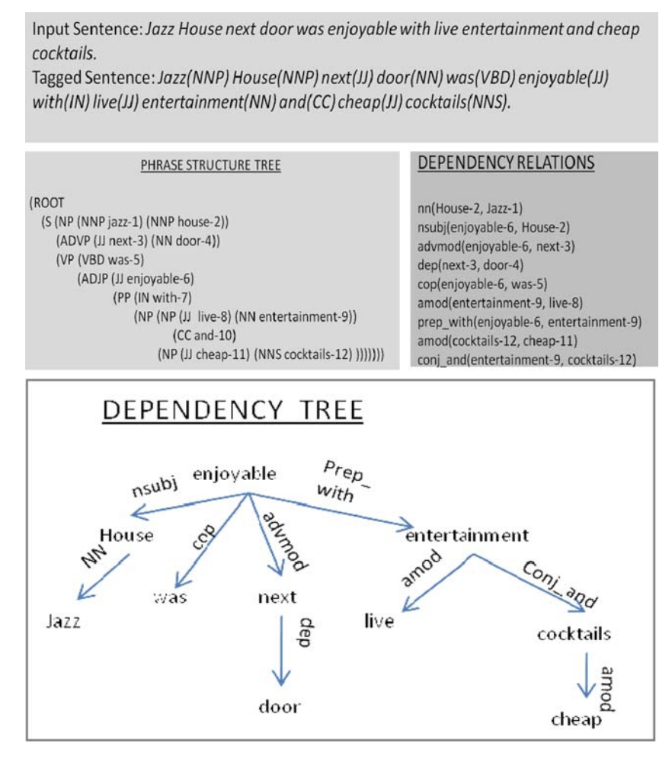
Handling Valence
Mine frequent adverb - adjective structured - learning apriori sequence mining algorithm
Dictionary of Adverbs - assign Valence
Enhancers - Very, Extremely - Pw* = Pw(1+w) and Nw* = Nw(1+w)
Negation - Not
Reducers - somewhat,
Pw* = Pw/(1+w) Nw* = Nw/(1+w)

Slide 48
COMPUTATIONAL WORK ON OTHER AFFECTIVE STATES
Emotion:
Detecting annoyed callers to dialogue system
Detecting confused/frustrated versus confident students
Mood:
Finding traumatized or depressed writers
Interpersonal stances:
Detection of flirtation or friendliness in conversations
Personality traits:
Detection of extroverts

Slide 49
DETECTION OF FRIENDLINESS
Friendly speakers use collaborative conversational style
Laughter
Less use of negative emotional words
More sympathy
That’s too bad I’m sorry to hear that
More agreement
I think so too
Less hedges
kind of sort of a little …

Slide 50
SUMMARY ON SENTIMENT
Generally modeled as classification or regression task
predict a binary or ordinal label
Features:
Negation is important
Using all words (in naïve bayes) works well for some tasks
Finding subsets of words may help in other tasks
Hand-built polarity lexicons
Use seeds and semi-supervised learning to induce lexicons

Slide 51
BEST OF LUCK FOR MINOR 2

